Slide 1
02 | Moving data to the cloud
Bret Stateham | Sr. Technical Evangelist
Christopher Harrison | Content Developer

Slide 2
Agenda
SQL Database
SQL in IaaS
NoSQL
Azure Blobs and Files
Notes:
Microsoft Azure provides a number of different storage and data services. We have already discussed some of the SQL offerings, and we’ll see those in action in a demo soon.
NoSQL is a general term that refers to a group of technologies that provide (non-relational) access to data that doesn’t work as well with relational databases such as key/value stores (Tables), document stores (DocumentDB). Other technologies such as MongoDB and Redis are available and can be used in Azure.
For straight-up storage needs, use Blob storage and File storage to persist your binary data.

Slide 3
SQL Database

Slide 4

The Basics
SQL Database
SQL Server database technology as a service
Fully Managed
Enterprise-ready with automatic support for HA
Designed to scale out elastically with demand
Ideal for simple and complex applications
Notes:
Let’s clear up any confusion and look at the basics of what SQL Database really is and some of its benefits.
The same great SQL Server database technology that you know, love, and use on-premises provided as a service
Enterprise-ready
Automatic support for High-Availability (3 copies of the database free for the cost of the one database, and always in sync)
Designed to scale on-demand

Slide 5
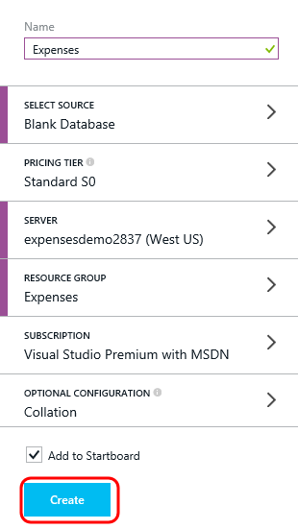
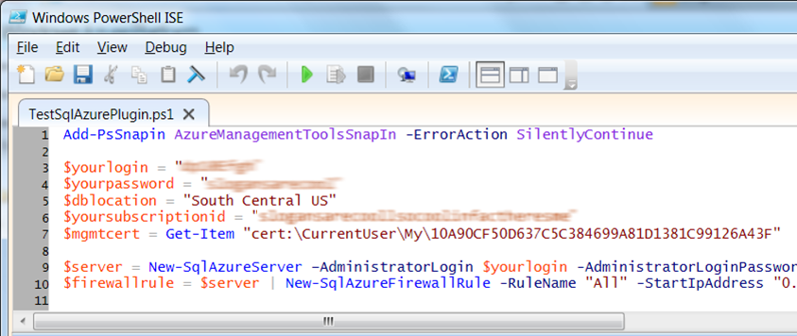
Server Provisioning
Server Defined
Service head that contains databases
Connect via automatically generated FQDN
(xxx.database.windows.net)
Initially contains only a master database
Provision Servers Interactively
Log on to Microsoft Azure Management Portal
Create a SQL Database server
Specify admin login credentials
Add firewall rules and enable service access
Automate Server Provisioning
Use Microsoft Azure Platform PowerShell cmdlets (or use REST API directly)
Notes:
Provisioning an on-premises SQL Server box can be time consuming, costly, and at times, a challenge. With SQL Database, provisioning a “server” is painless, quick, and provisioned in a matter of seconds.
Provision servers interactively using the Management Portal
Automate server provisioning using the Microsoft Azure Management API or PowerShell.
While the “server” is technically a TDS endpoint, much of the SQL Server process is similar. Administration login credentials are still needed for security, and more importantly defining service access is essential, and required, for maintaining the integrity of your server through firewall rules.

Slide 6
SQL in IaaS

Slide 7
Run SQL in a VM
Run any SQL product on cloud VM
Support for SQL Server, Oracle, MySql
Ready to go VM images available in Marketplace
Persistent storage using attached disk in blob storage
Notes:
Running SQL in a virtual machine allows you to move enterprise breadth applications from on-premises to Azure.

Slide 8
SQL Database vs SQL IaaS Comparison
SQL Database
Fully managed SQL Server environment
HA/DR features automatically included
Automatic backup enabled by default
SQL IaaS
Choice of a variety of DB engines (SQL Server, Oracle, MySql)
Larger database sizes possible (16TB)
All features of native DB available
Windows authentication available (requires VM to be joined to on-premises domain)

Slide 9
SQL Database

Slide 10
NoSQL

Slide 11
NoSQL on Azure
Azure Tables service is NoSQL row store
MongoDB is a document (JSON) store
Cassandra is a columnar store with excellent replication
HBase is a Big Data (Hadoop) NoSQL store available in HDInsight
Notes:
Not all data needs are best served by a relational technology. Sometimes it is the nature of the data itself that doesn’t fit well, such as storing documents. Other times the relational technology doesn’t scale cost effectively enough for very large data sets.

Slide 12
NoSQL advantages
The storage engines of NoSQL stores are designed to minimize contentions enabling higher throughput and therefore more scalability
Lower transaction capability in NoSQL results in less contention and therefore more scalability
Less complex query processor means that a single query can’t degrade service
Built-in replication capability means the store can scale out, which better aligns with other application tiers (e.g. websites)
No fixed schema or lower schema requirements

Slide 13
Azure Blobs and Files

Slide 14
Blob Storage
Service for large amounts of unstructured data
Accessible from anywhere via HTTP or HTTPS
Common uses of Blob storage include:
Serving images or documents directly to a browser
Storing files for distributed access
Streaming video and audio
Performing secure backup and disaster recovery

Slide 15
Blob Storage Concepts
http://<account>.blob.core.windows.net/<container>/<blobname>
Account
Container
Blob
PIC01.JPG
images
PIC02.JPG
contoso
videos
VID1.AVI
Notes:
The Blob service provides storage for entities, such as binary files and text files.
The REST API for the Blob service exposes two resources:
Containers
Blobs.
A container is a set of blobs; every blob must belong to a container.
The Blob service defines two types of blobs:
Block blobs, which are optimized for streaming.
Page blobs, which are optimized for random read/write operations and which provide the ability to write to a range of bytes in a blob.

Slide 16

Azure Files
Shared Network File Storage for Azure
Availability, durability, scalability are managed automatically
Supports two interfaces: SMB and REST
IaaS VM
IaaS VM
IaaS VM
PaaS VM
Azure File Share
(PaaS)
Notes:
Share files between virtual machines using standard and familiar file system APIs like ReadFile and WriteFile. This makes it easier to “lift and shift” applications to the cloud that use on-premise file shares to share data between parts of the application.
This service is build on the same technology as Blob and Table services.

Slide 17
Azure Files vs Blobs
Description | Azure Blobs | Azure Files
Durability Options | LRS, ZRS, GRS (and RA-GRS for higher availability) | LRS, GRS
Accessibility | REST APIs | SMB 2.1 (standard file system APIs) REST APIs
Connectivity | REST – Worldwide | SMB 2.1 - Within region REST – Worldwide
Endpoints | http://myaccount.blob.core.windows.net/mycontainer/myblob | \\myaccount.file.core.windows.net\myshare\myfile.txt http://myaccount.file.core.windows.net/myshare/myfile.txt
Directories | Flat namespace however prefix listing can simulate virtual directories | True directory objects
Case Sensitivity of Names | Case sensitive | Case insensitive, but case preserving
Capacity | Up to 500TB containers | 5TB file shares
Throughput | Up to 60 MB/s per blob | Up to 60 MB/s per share
Object size | Up to 1 TB/blob | Up to 1 TB/file
Billed capacity | Based on bytes written | Based on file size
Notes:
Here are some additional details need to be taken into consideration when deciding to use Azure Files or Blob storage.

